Slide 1
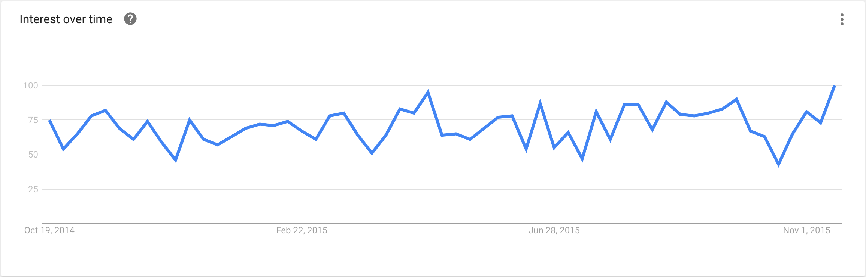
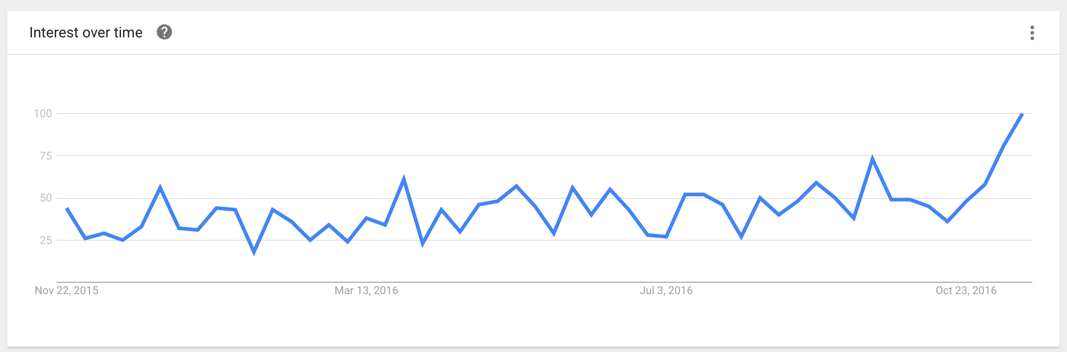
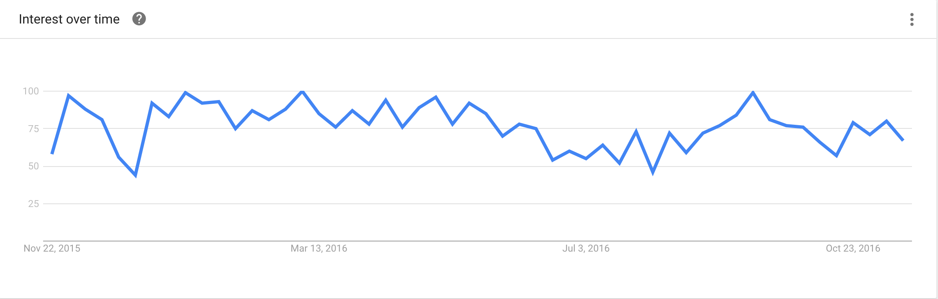
problem you are addressing?
Google Trends 2016
Google Trends 2016
Interest in the past year
“near me’’ volunteer search results over past 5 years
Sebrina had that one good stat to put in this slide!
Google Trends 2016
Community service results in past year

Slide 2
solve the problem
Simple and easily accessible
No longer a confusing site
Helps integrate volunteerism into the everyone’s culture
Helps out non profit organizations by marketing so they can focus on the philanthropy
Makes the process of volunteer work seem simple and inviting

Slide 3
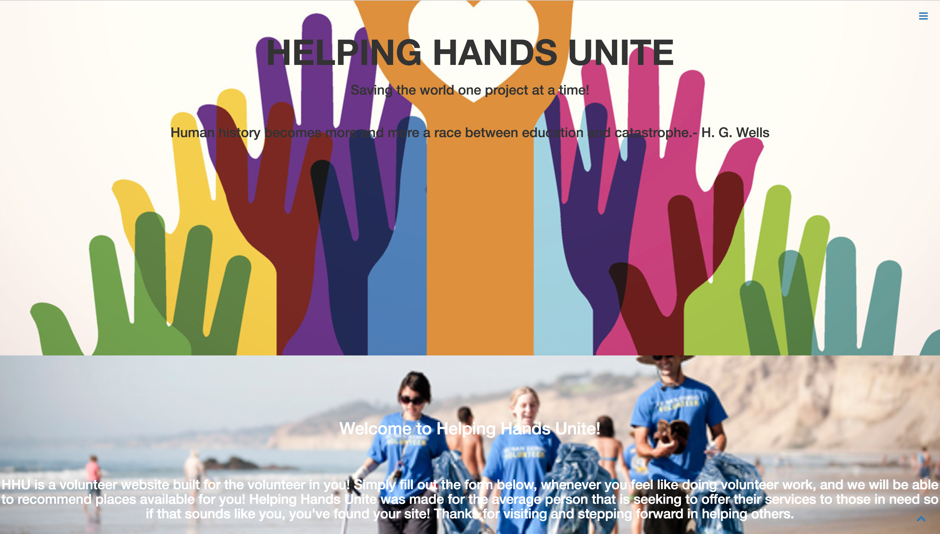
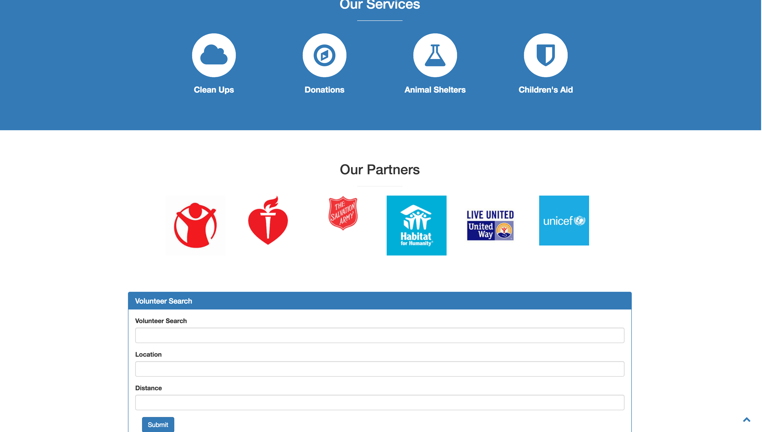
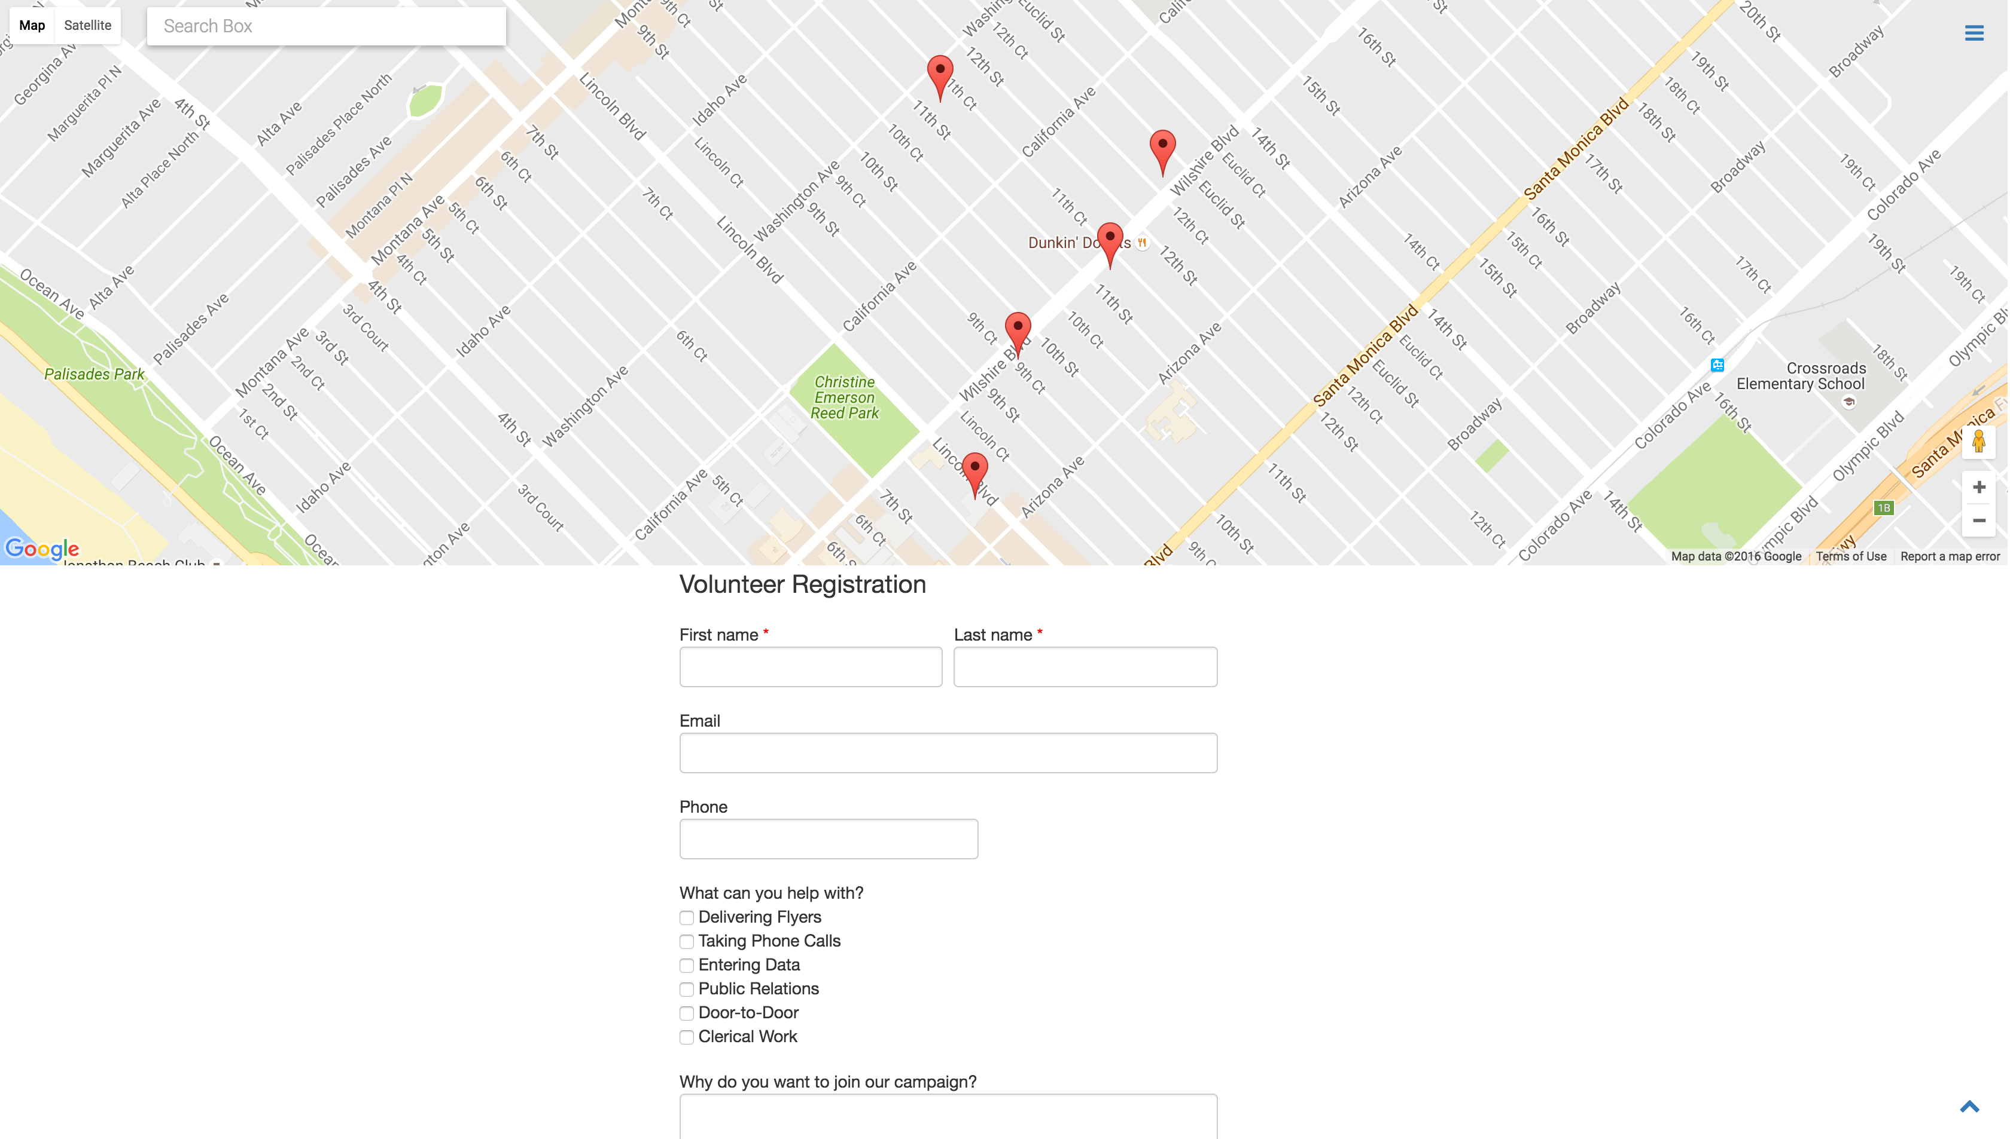
Our Site

Slide 4
How are we different?
Googlemaps, volunteermatch.com only show you where these companies are. We take it to the next step by submitting your application for you so it minimizes the time it takes to communicate to organizations and scheduling available dates, avoid long and hefty application forms
Our company is a marketing site for volunteer sites as well as possible volunteer workers
Organizations need volunteers so we are a continuous flow of workers for them

Slide 5
Coming soon…
This is only phase 1
Next is to integrate a calendar,
More attainable for volunteers as well as organizations to know what’s available and when.
Once a organization has been chosen by a user the volunteer form of that organization is linked
Allow people to post on this site to create volunteer jobs
That way more opportunities to volunteer come up.

